Slide 1
Implementing Various Delta Hedging Strategies
Notes:
Introduction to the Project:
Welcome to our presentation on "Employing Different Delta Hedging Strategies for Risk Management."
Financial markets are inherently uncertain and subject to volatility, making risk management a critical aspect of investment and trading strategies.
As market participants seek to optimize returns while minimizing potential losses, understanding and implementing effective risk management techniques become paramount.
In this project, we delve into the realm of options trading, specifically focusing on delta hedging strategies as a means to manage risk in volatile market conditions.
2. Importance of Risk Management:
Risk management forms the bedrock of sound investment practices, guiding investors in making informed decisions to safeguard their capital.
By actively managing risks, investors can protect their portfolios from adverse market movements and potential downturns, thereby preserving wealth over the long term.
In options trading, where investments are often leveraged and market dynamics can change rapidly, the need for robust risk management strategies is even more pronounced.
Delta hedging, a technique widely used in options trading, enables investors to offset the risk associated with changes in the underlying asset's price, thereby stabilizing their positions and reducing exposure to market fluctuations.
3. Objective of the Study:
The primary objective of our study is to empirically assess the effectiveness of different delta hedging strategies in managing risk and optimizing returns.
Through the utilization of Monte Carlo simulations, we aim to simulate a diverse range of market scenarios and evaluate the performance of dynamic, static, and no hedging strategies.
By rigorously analyzing the outcomes of these simulations, we seek to gain insights into the relative strengths and weaknesses of each strategy under various market conditions.
Ultimately, our goal is to provide investors and traders with actionable insights that can inform their decision-making processes and enhance their risk management capabilities in options trading.
4. Key Focus Areas:
Our study is structured around three primary focus areas: understanding the mechanics of delta hedging, comparing the performance of dynamic and static hedging strategies, and assessing the impact of forgoing hedging altogether.
We will delve into the theoretical underpinnings of delta hedging, elucidating its role in options pricing and risk management.
Through comparative analysis, we will evaluate the efficacy of dynamic and static hedging strategies in mitigating risk and optimizing returns across different market scenarios.
Additionally, we will examine the implications of adopting a no hedging approach, exploring the potential risks and rewards associated with this strategy.
5. Expected Outcomes:
Through our research, we anticipate gaining valuable insights into the factors influencing profit and loss within delta hedging strategies.
By systematically analyzing the performance of dynamic, static, and no hedging strategies through Monte Carlo simulations, we aim to identify the key drivers of profitability and risk exposure.
These insights will enable us to provide practical recommendations for investors and traders seeking to enhance their risk management practices in options trading.
Ultimately, our findings will contribute to the existing body of knowledge on delta hedging strategies and provide actionable guidance for navigating the complexities of financial markets effectively.

Slide 2
Presentation Outline
Introduction
Concepts:
Delta Hedge
Monte Carlo Methods
Methodology:
Hedging Strategies
Performance Comparison
Conclusion
Notes:
Here is the project outline as we are gonna go through our presentation.
1. Importance of Risk Management:
Risk management forms the bedrock of sound investment practices, guiding investors in making informed decisions to safeguard their capital.
By actively managing risks, investors can protect their portfolios from adverse market movements and potential downturns, thereby preserving wealth over the long term.
In options trading, where investments are often leveraged and market dynamics can change rapidly, the need for robust risk management strategies is even more pronounced.
Delta hedging, a technique widely used in options trading, enables investors to offset the risk associated with changes in the underlying asset's price, thereby stabilizing their positions and reducing exposure to market fluctuations.
Additionally, we will examine the implications of adopting a no hedging approach, exploring the potential risks and rewards associated with this strategy.
2. Key Focus Areas:
Our study is structured around three primary focus areas: understanding the mechanics of delta hedging, comparing the performance of dynamic and static hedging strategies, and assessing the impact of forgoing hedging altogether.
We will delve into the theoretical underpinnings of delta hedging, elucidating its role in options pricing and risk management.
Through comparative analysis, we will evaluate the efficacy of dynamic and static hedging strategies in mitigating risk and optimizing returns across different market scenarios.

Slide 3
Introduction
The primary objective of our study is to empirically assess the effectiveness of different delta hedging strategies in managing risk and optimizing returns.
Through the utilization of Monte Carlo simulations, we aim to simulate a diverse range of market scenarios and evaluate the performance of dynamic, static, and no hedging strategies.
Ultimately, our goal is to provide investors and traders with actionable insights that can inform their decision-making processes and enhance their risk management capabilities in options trading.
Notes:
Introduction to the Project:
Financial markets are inherently uncertain and subject to volatility, making risk management a critical aspect of investment and trading strategies.
As market participants seek to optimize returns while minimizing potential losses, understanding and implementing effective risk management techniques become paramount.
In this project, we delve into the realm of options trading, specifically focusing on delta hedging strategies as a means to manage risk in volatile market conditions.
Benefits of Delta Hedging:
Delta hedging helps traders manage risk by offsetting the price risk associated with options positions.
It allows traders to maintain a more stable portfolio value, particularly in volatile markets.
Delta hedging can be an effective strategy for minimizing losses and maximizing profits in options trading.

Slide 4
Project Structure
Strategy and Concept Research
Data Collection and Market Simulation
Delta Hedging Simulation
Results Analysis
Delta Hedge
Monte Carlo Methods
YahooFinance - SPY ETF
Dynamic Hedge
Static Hedge
No Hedge
Summary Statistics
Performance Comparison
Notes:
1. Data Preparation and Importing:
Import necessary libraries such as datetime, pandas, numpy, yfinance, and matplotlib.
Download historical stock price data using Yahoo Finance API.
2. Implied Volatility Calculation:
Calculate implied volatility for European options using the Black-Scholes model.
Iteratively calculate the volatility needed to match the market price of the option.
3. Simulating Stock Price Movements:
Employ Geometric Brownian motion to simulate stock price movements over time.
Perform multiple simulations to generate different paths for the stock price.
4. Delta Hedging Simulation:
Simulate delta hedging for each path of the stock price.
Calculate delta of the option at each time step using the Black-Scholes model.
Compute total delta position and adjustments to manage the delta risk.
Determine adjustment actions (buy or sell) and cash flows based on changes in delta.
Calculate interest accrued on adjustments.
The methodology employed in this code revolves around simulating and analyzing delta hedging strategies for options trading. It starts with data preparation and importing libraries, followed by downloading historical stock price data using Yahoo Finance API. Implied volatility is then calculated for European options using the Black-Scholes model, and stock price movements are simulated using Geometric Brownian motion. Delta hedging is simulated for each path of the stock price, where delta of the option is calculated at each time step and adjustments are made to manage the delta risk. We then analyze profit and loss components, including original option P&L, original stock P&L, adjustment P&L, and interest accrued on adjustments. Visualizations are created to visualize the distribution of total cashflows for different hedging strategies, and summary statistics are calculated to evaluate the overall performance of each strategy. This methodology allows us to assess the effectiveness of dynamic delta hedging compared to static delta hedging and no hedging strategies in terms of profitability and risk management.

Slide 5
Concept: Delta Hedge
Delta hedging is an options trading strategy aimed at reducing and/or eliminating the risk associated with changes in the price of the underlying asset.
It involves adjusting the portfolio of options and the underlying asset in such a way that changes in the price of the underlying asset have minimal impact on the overall value of the portfolio.
Notes:
Understanding Delta:
Delta measures the sensitivity of an option's price to changes in the price of the underlying asset. It ranges from -1 to 1 for put options and from 0 to 1 for call options.
Delta values can be interpreted as probabilities. For instance, a call option with a delta of 0.70 implies that there's a 70% chance the option will finish in-the-money by expiration.
Importance of Delta:
Delta, a key parameter in options pricing, measures the sensitivity of an option's price to changes in the price of the underlying asset. It represents the change in option price for a $1 change in the underlying asset's price. Delta can range from -1 to 1 for put options and from 0 to 1 for call options.
Comparison of Strategies:
Each delta hedging strategy has its own advantages and disadvantages, which may depend on factors such as market conditions, trading objectives, and risk tolerance. Understanding the characteristics of each strategy is crucial for effective risk management and portfolio optimization in options trading.

Slide 6
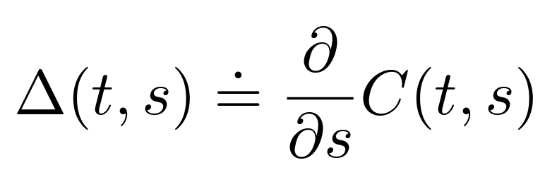
Concept: Delta Hedge
Delta Hedge Equation: Δ(t,s) = Delta of the Option
𝞭C(t,s) = Change in Option Price
𝞭s = Change in Underlying Assets Price
Notes:
Delta hedging is a strategy used in options trading to offset the risk associated with changes in the price of the underlying asset. The delta of an option measures the sensitivity of the option's price to changes in the price of the underlying asset. The basic principle behind delta hedging is to establish a position in the underlying asset that will offset the changes in the option's price, thereby creating a delta-neutral portfolio.
The formula for delta is typically denoted as:
Δ=∂V / ∂S
Where:
Δ = Delta of the option
V = Value of the option
S = Price of the underlying asset
To delta hedge an options position, traders calculate the delta of the option and then establish a position in the underlying asset that has an equivalent delta value. This ensures that changes in the price of the underlying asset will be offset by corresponding changes in the value of the options position, resulting in a delta-neutral portfolio.
For example, if the delta of a call option is 0.70, this means that for every one-point increase in the price of the underlying asset, the value of the call option is expected to increase by $0.70. To delta hedge this position, the trader would need to establish a short position in the underlying asset with a delta of -0.70. This ensures that changes in the price of the underlying asset are offset by changes in the value of the short position, resulting in a delta-neutral portfolio.

Slide 7
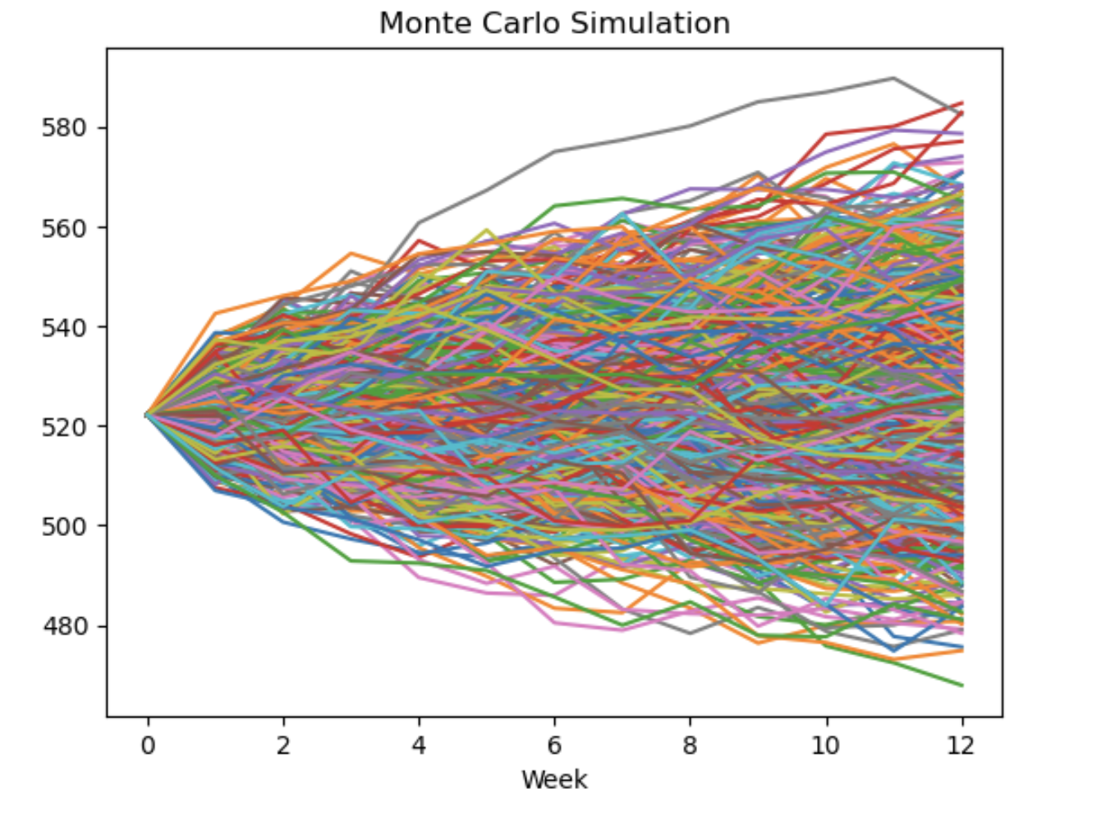
Concept: Monte Carlo Simulation
Monte Carlo Simulations are computational algorithms used to model the probability of different outcomes in a process that cannot easily be predicted due to the intervention of random variables.
Notes:
Introduction to Monte Carlo Simulations:
Monte Carlo simulations are computational algorithms used to model the probability of different outcomes in a process that cannot easily be predicted due to the intervention of random variables.
These simulations involve repeated random sampling to obtain numerical results. They are particularly useful in finance for assessing the risk associated with various investment strategies.
Description of the Model:
Our model utilizes Monte Carlo simulations to generate multiple possible future stock price paths.
We incorporate factors such as volatility, interest rates, and dividend yields to create realistic scenarios.
Each simulation represents a potential evolution of the stock price over a specified period.
Simulation Parameters and Assumptions:
We set the parameters for the simulations based on historical data and market conditions.
Assumptions include constant volatility, risk-free interest rate, and absence of transaction costs.
We conduct 1,000 simulations to ensure robustness in our results.
The simulations are run over a predefined time horizon, typically ranging from a few days to several months.
Advantages of Monte Carlo Simulations:
Flexibility: Monte Carlo simulations allow for the incorporation of complex models and multiple variables, providing a comprehensive analysis of possible outcomes.
Risk Assessment: By generating a large number of scenarios, these simulations help in assessing the potential risks associated with different strategies.
Decision Support: The insights gained from Monte Carlo simulations aid decision-making processes by providing probabilistic forecasts and identifying optimal courses of action.
Monte Carlo simulations use randomness to simulate a process many times, allowing you to understand the range of possible outcomes and their probabilities. They're incredibly useful for decision-making in situations where outcomes are uncertain or influenced by random variables.
Our model utilizes Monte Carlo simulations to generate multiple possible future stock price paths based on the realized volatility and interest rates to create realistic scenarios.

Slide 8
Methodology: Strategies
Delta Hedging Strategy | Description | Adjustment | Goal
Dynamic Hedge | Adjusts hedge ratio continuously based on delta changes. | Weekly adjustments | Maintain delta-neutral position
Static Hedge | Establishes a fixed hedge ratio at outset. | No adjustments | Fixed hedge based on initial delta
No Hedge | Holds option without hedging against price changes. | None | Expose to full price risk
Notes:
Dynamic Delta Hedging:
Continuous Adjustment: Dynamic delta hedging involves continuously adjusting the hedge ratio based on changes in the underlying asset's price and the option's delta.
Delta-Neutral Position: The primary objective is to maintain a delta-neutral position, where the overall delta of the portfolio is zero. This means that changes in the option's value are offset by corresponding changes in the value of the underlying asset.
Periodic Rebalancing: Adjustments are made periodically, typically at predetermined intervals or whenever the delta deviates significantly from zero. This ensures that the hedge remains effective over time and adapts to evolving market conditions.
Risk Management: Dynamic delta hedging provides effective risk management by reducing exposure to fluctuations in the underlying asset's price. By continuously rebalancing the hedge, traders can minimize the impact of price movements on their overall portfolio.
Static Delta Hedging:
Fixed Hedge Ratio: In static delta hedging, a fixed hedge ratio is established at the outset of the position and maintained throughout the option's lifespan. The hedge ratio is determined based on the initial delta of the option.
Limited Adjustment: Unlike dynamic delta hedging, the hedge ratio is not adjusted in response to changes in the underlying asset's price or the option's delta. This simplifies the hedging process but may result in less effective risk management.
Simplicity: Static delta hedging is relatively straightforward to implement and requires less frequent monitoring compared to dynamic delta hedging. Traders can establish the hedge ratio based on their risk tolerance and market outlook and then leave it unchanged until the option expires.
Drawbacks: While static delta hedging may offer simplicity, it may not provide optimal risk management, especially in volatile markets. The fixed hedge ratio may become less effective over time as market conditions change, leading to potential losses if the hedge is not adjusted accordingly.
No Hedging:
Speculative Position: No hedging involves holding the option position without any attempt to hedge against changes in the underlying asset's price. Traders rely solely on the directional movement of the underlying asset to generate profits.
Full Price Risk: By not hedging, traders expose themselves to full price risk. If the market moves unfavorably, the value of the option position can decline significantly, leading to potential losses.
Potential for High Returns: While no hedging carries higher risk, it also offers the potential for higher returns. If the market moves in the trader's favor, they can profit from the full extent of the price movement without the constraints of a hedge.
Not Recommended for Risk-Averse Investors: No hedging is typically considered a speculative strategy and is not recommended for risk-averse investors or those seeking to protect their capital. It requires a high tolerance for risk and a thorough understanding of market dynamics.

Slide 9
Dynamic Hedging Strategy (Example)
Short 1 Contract of At-the-Money Call (Fixed)
SPY Price = 520
Week | Price | Delta | Total Delta Position | Adjustment Shares | Total Adjustment
0 | 520 | -54 | 0 | NaN | NaN
1 | 518.01 | -51 | 3 | Sell 3 | Short 3
. . . | . . .
10 | 528.57 | -84 | -38 | Buy 38 | Long 30
11 | 523.52 | NaN | NaN | Sell 30 | NaN
Notes:
We are short a call option here so we are negative delta of 54. To make it delta neutral we actually need to buy back as soon as we sell the call 54 shares in the underlying at the price 102 now.
Every week for the next 11 weeks we're going to come into the marketplace see the price so next week it's a $101.61 so we calculate the delta we look at the change in that delta position we've got a +3 delta so we actually need to hedge that and sell three contracts in the underlying.
We keep doing this week after week, next week it's 102.5 so the price has gone up so our delta is now short we need to go adjust that by buying six contracts and so on and so forth now we keep tabs of this every week and by the final week we calculate our long position which is 30 overall in week 10 we sell our 30 stocks in the last week

Slide 10
Dynamic Hedging Strategy (Example)
Dynamic hedging results
Original Option P&L | $ 189.50
Original Stock P&L | $ 37.26
Adjustment P&L | $ -94.53
Carry (Interest) on Option | $ 1.07
Carry (Interest) on Stock | $ -22.93
Interest on Adjustments | $ 0.37
TOTAL CASH FLOW | $ 110.74
Notes:
Let’s consider the entire P&L of this option position with dynamic hedging by considering the components on the right hand side so for the original option P&L we have is 100(2.585-max(102.69-102,0)))= 189.50
We get that premium up front so we get to earn interest on the option so you can calculate that using this 2.585* 100* 2%* 0.21= 1.0765 interest on that premium
Remember we had to buy 54 stocks at the very beginning and we actually end up making a total return of 54(102.69-102)= 37.26 on that original stock purchase
The reason we were able to buy that stock is because we borrowed money from the money market and the interest we have to pay back on that is -54 * 102* 2%* 0.208= -22.90 now
For the adjustment cash flow all you need to do is add up that column which gives $-94.53
We can see and the same thing for the interest on the adjustments which totals $0.37
By taking into consideration all of these components we get a total cash flow of $110.74

Slide 11
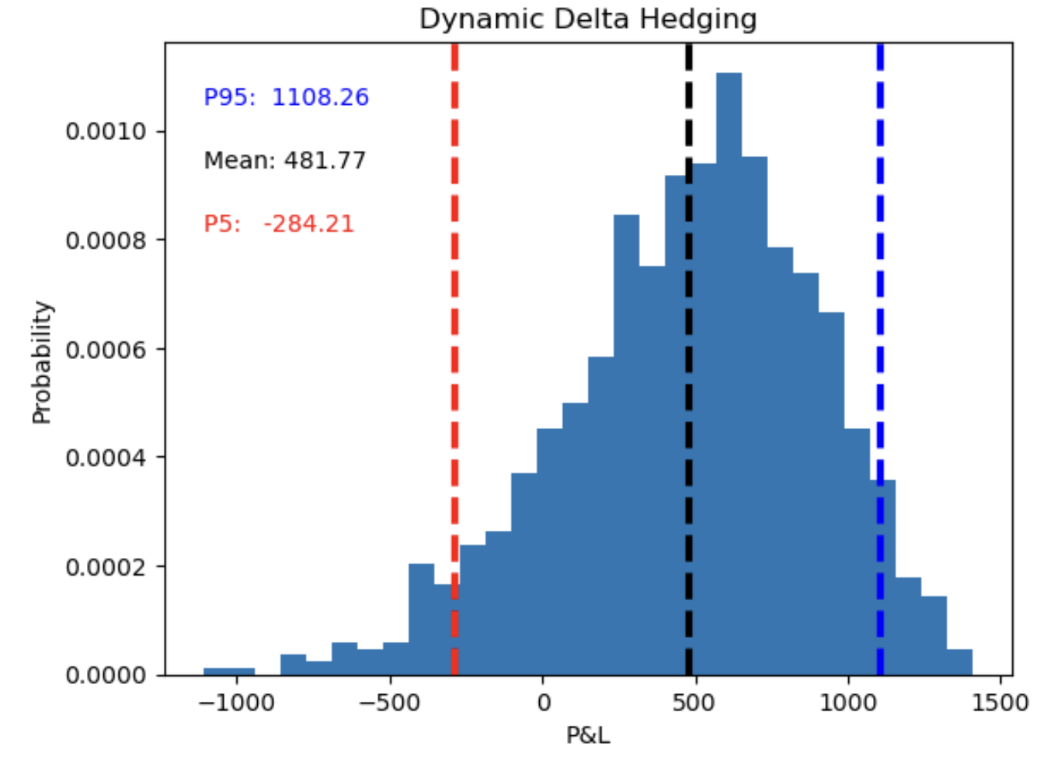
Dynamic Hedging Strategy
Notes:
We can see from the dynamic delta hedging distribution there that we've got a mean of $481.77 with an upside P95 of $1108.26 and p5 on the downside is $-284.21

Slide 12
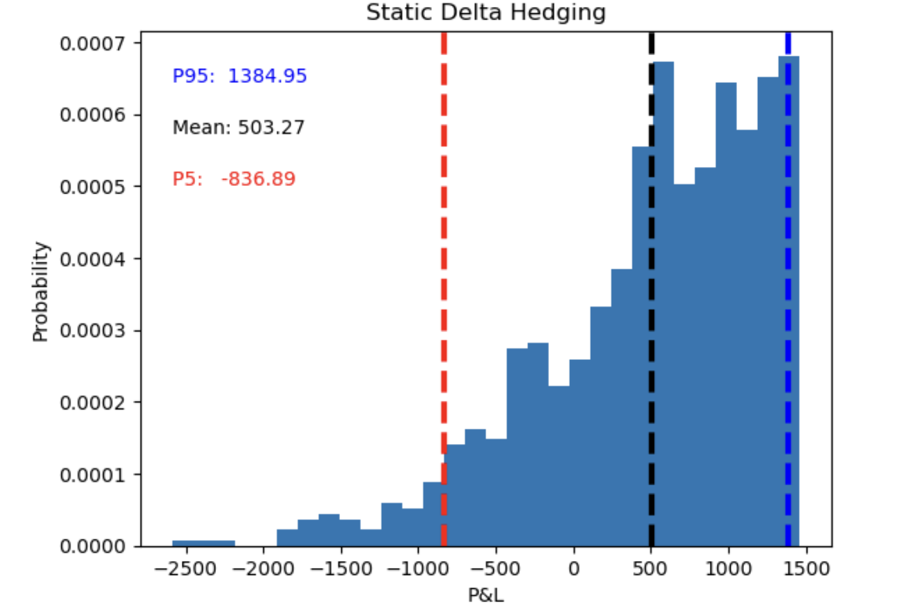
Static Hedging Strategy
Notes:
Now the static delta hedging which only happens once we have got a mean of $503.27 with an upside P95 of $1384.95 and we can see that p5 on the downside is $-836.89

Slide 13
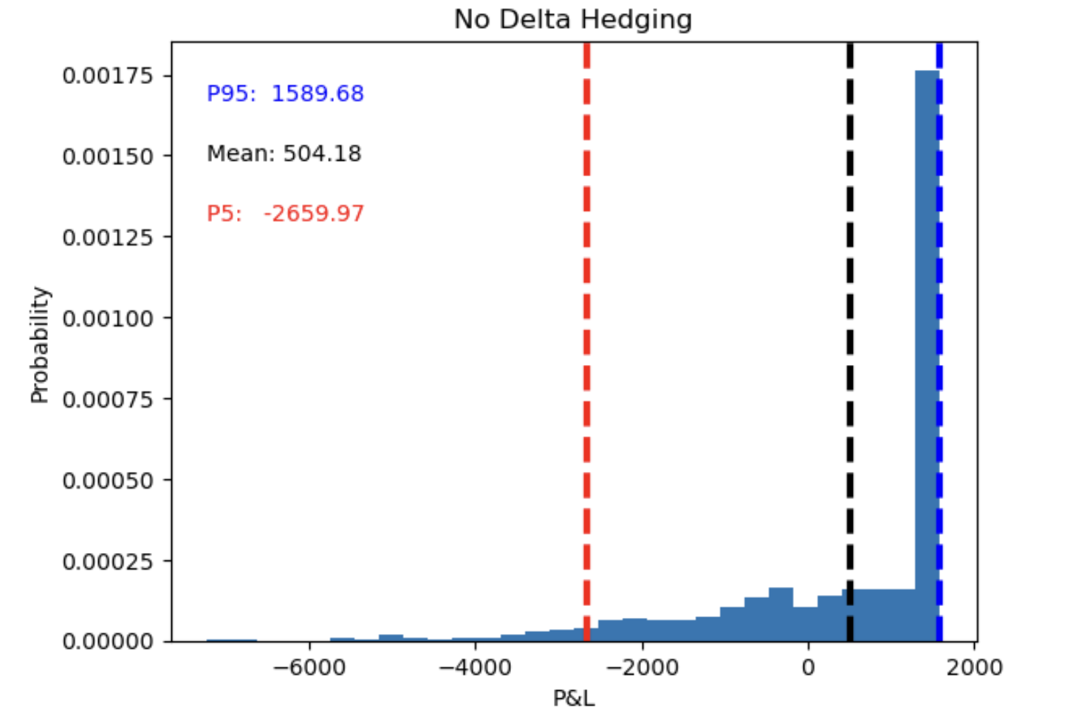
No - Hedge Strategy
Notes:
No delta hedging we've got a mean of $504.18 with an upside P95 of $1589.68 and we can see that p5 on the downside is $-2659.97

Slide 14
Performance of Strategies
Short Call (Realized volatility = 0.11)
 | P5 | Mean | P95 | P95 - P5 (90% Confidence Interval)
Dynamic Hedge | -284.21 | 481.77 | 1108.26 | 1392.47
Static Hedge | -836.89 | 503.27 | 1384.95 | 2221.84
No Hedge | -2659.97 | 504.18 | 1589.68 | 4249.65
Notes:
We looked at these different scenarios one where we've dynamically delta hedged, one where we're statically delta hedged and then one where we don't delta hedge at all
Based on these options(short call) profit and loss distributions even though means are similar, No hedging strategy has worse P5 outcome but has lager P95 upside
Dynamic hedging here provides the downside risk of only $-284.21 and hence can be considered better than other strategies.

Slide 15
Performance of Strategies
Realized Volatility | Dynamic Hedging |  | Static Hedging |  | No Hedging
 | P5 | P95 | P5 | P95 | P5 | P95
0.02 | 1141.9 | 1365.04 | 1058.83 | 1412.38 | 631.58 | 1589.68
0.05 | 673.37 | 1285.63 | 328.69 | 1419.02 | -650.42 | 1589.68
0.08 | 239.81 | 1212.7 | -382.48 | 1381.45 | -1706.57 | 1589.68
0.11 | -284.21 | 1108.26 | -836.89 | 1384.95 | -2659.97 | 1589.68
0.14 | -713.82 | 984.46 | -1689.24 | 1362.36 | -4281.42 | 1589.68
0.17 | -1223.92 | 846.86 | -2448.86 | 1340.83 | -5388.37 | 1589.68
0.20 | -1595.73 | 726.83 | -2990.73 | 1316.93 | -6528.77 | 1589.68
Notes:
While taking a short positions in call options, as realized volatility increases Dynamic hedging provides low downside risk compared to other hedging strategies

Slide 16
Performance of Strategies
Short Put (Realized Volatility = 0.11)
 | P5 | Mean | P95 | P95 - P5 (90%Confidence Interval)
Dynamic Hedge | -657.04 | 95.12 | 696.24 | 1353.28
Static Hedge | -1318.77 | 70.64 | 1021.32 | 2340.09
No Hedge | -3034.52 | -9.43 | 994.18 | 4028.70
Notes:
We looked at these different scenarios one where we've dynamically delta hedged, one where we're statically delta hedged and then one where we don't delta hedge at all
Based on these options(short put) profit and loss distributions , No hedging strategy has worse P5 outcome
Dynamic hedging here provides the downside risk of only $-657.04 and hence can be considered better than other strategies.

Slide 17
Performance of Strategies
Realized Volatility | Dynamic Hedging |  | Static Hedging |  | No Hedging
 | P5 | P95 | P5 | P95 | P5 | P95
0.02 | 780.19 | 1002.79 | 647.67 | 1047.98 | 438.73 | 994.18
0.05 | 333.27 | 992.66 | 40.79 | 1053.95 | -645.32 | 994.18
0.08 | -131.76 | 822.93 | -674.57 | 1051.16 | -1649.67 | 994.18
0.11 | -657.04 | 696.24 | -1318.77 | 1021.32 | -3034.52 | 994.18
0.14 | -1073.36 | 636.37 | -1957.01 | 985.07 | -4077.17 | 994.18
0.17 | -1592.99 | 476.04 | -2868.27 | 978.24 | -5253.62 | 994.18
0.20 | -2074.05 | 338.83 | -3502.7 | 955.75 | -6148.17 | 994.18
Notes:
While taking a short positions in put options, as realized volatility increases Dynamic hedging provides low downside risk compared to other hedging strategies

Slide 18
Conclusion
Hedging Strategy | P95 - P5 (90% Range) | P5 | P95 | Risk Management
Dynamic Hedge | Lowest | Highest | Lowest | Effective risk management
Static Hedge | Higher than dynamic hedge | Lower than dynamic hedge | Higher than dynamic hedge | Less effective than dynamic
No Hedge | Highest | Lowest | Highest | Speculative, high risk
Notes:
Dynamic delta hedging provides effective risk management by continuously rebalancing the hedge as the underlying fluctuates.. By continuously rebalancing the hedge, traders can minimize the impact of price movements on their overall portfolio
While Static delta hedging may offer simplicity, it may not provide optimal risk management, especially in volatile markets. The fixed hedge ratio may become less effective over time as market conditions change, leading to potential losses if the hedge is not adjusted accordingly.
No hedging is typically considered a speculative strategy and is not recommended for risk-averse investors or those seeking to protect their capital. It requires a high tolerance for risk and a thorough understanding of market dynamics.

Slide 19
FUTURE WORK
Dynamic Hedging Optimization:
Exploring different re-calibrating frequency
Adding market friction (example: transaction costs)
Volatility Simulation:
Explore the feasibility of the hedging strategies in changing volatility conditions
Backtest Strategy:
Test the effectiveness of the three different strategies using historical data
Notes:
Dynamic Hedging Optimization
Turning to hedging strategies, we examine the impact of increasing the frequency of hedging adjustments and accounting for transaction fees. Here lies a critical question: Is there an optimal number of hedging instances that balances risk management effectiveness and cost efficiency? Our analysis suggests that while more frequent adjustments can lead to better risk mitigation, transaction costs must not be overlooked. Finding this balance is crucial for optimizing our hedging strategy.
Volatility Simulation
One of the challenges in stock market simulations is the assumption of fixed volatility. In reality, stock volatility is anything but static; it fluctuates daily based on market dynamics. To address this, we incorporate the GARCH(1,1) model. This model enables us to simulate volatility dynamically, offering a more realistic portrayal of stock price movements.
Real World Data Comparison
Lastly, we ground our discussion in reality by comparing the effectiveness of three strategies using real-world data. This comparative analysis not only validates our theoretical models but also offers practical insights into their application and performance in actual market conditions.

Slide 20
Thank You!

